Slide 1
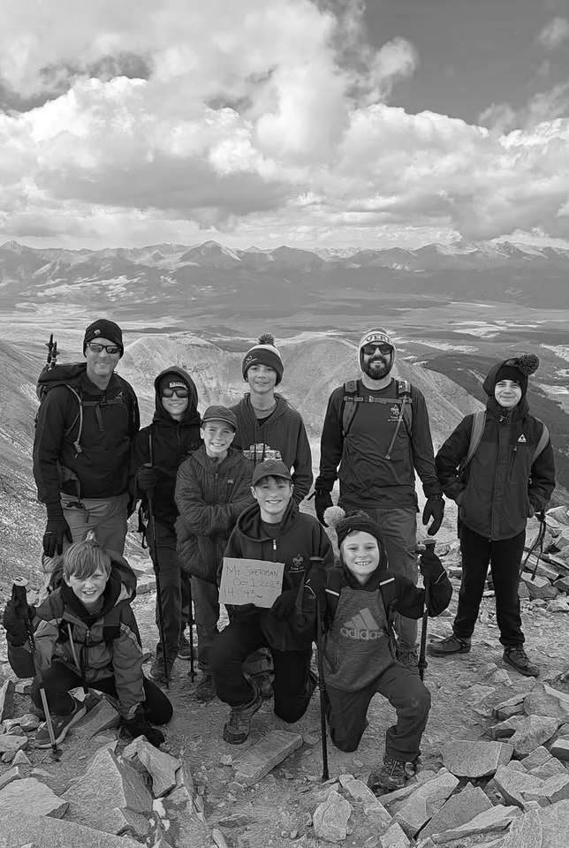
King soopers how to link your account
Presented by Jen Swiderski

Slide 2
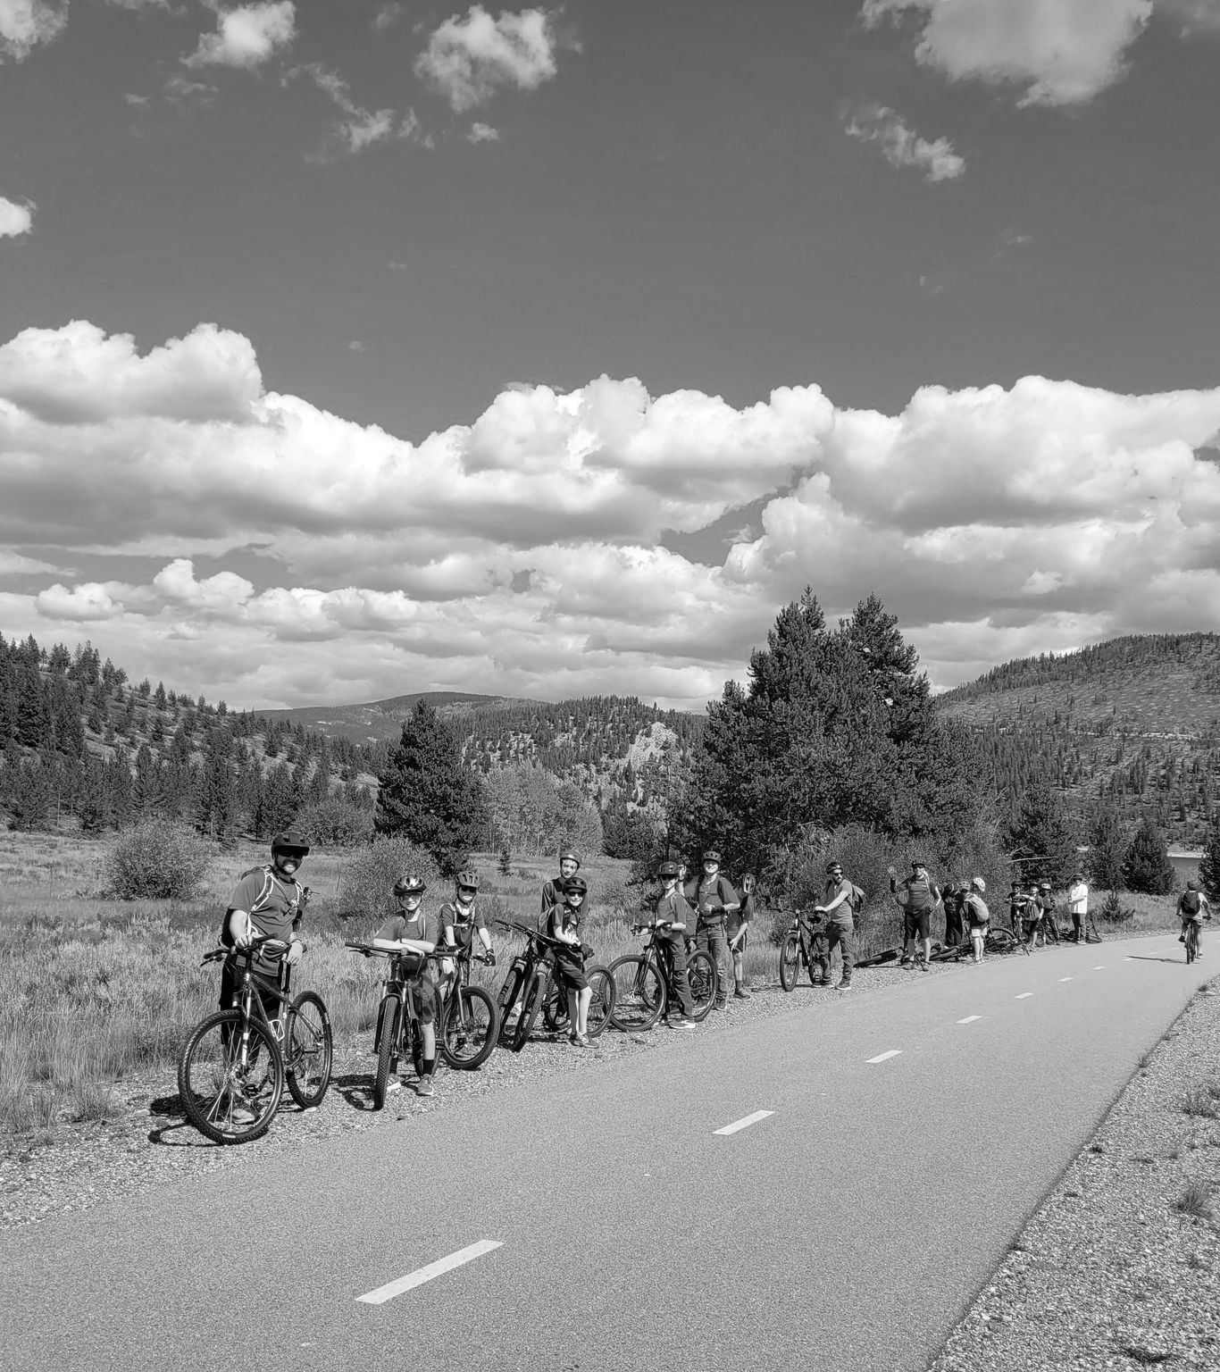
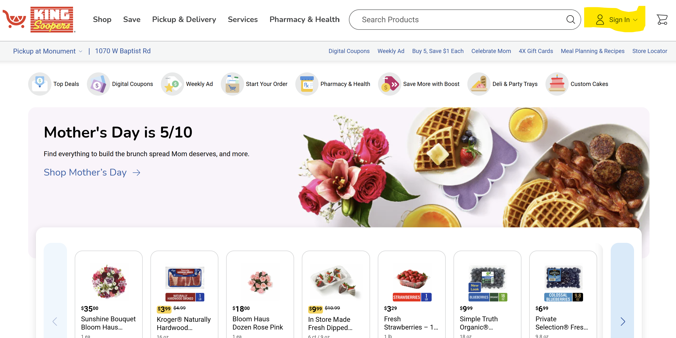
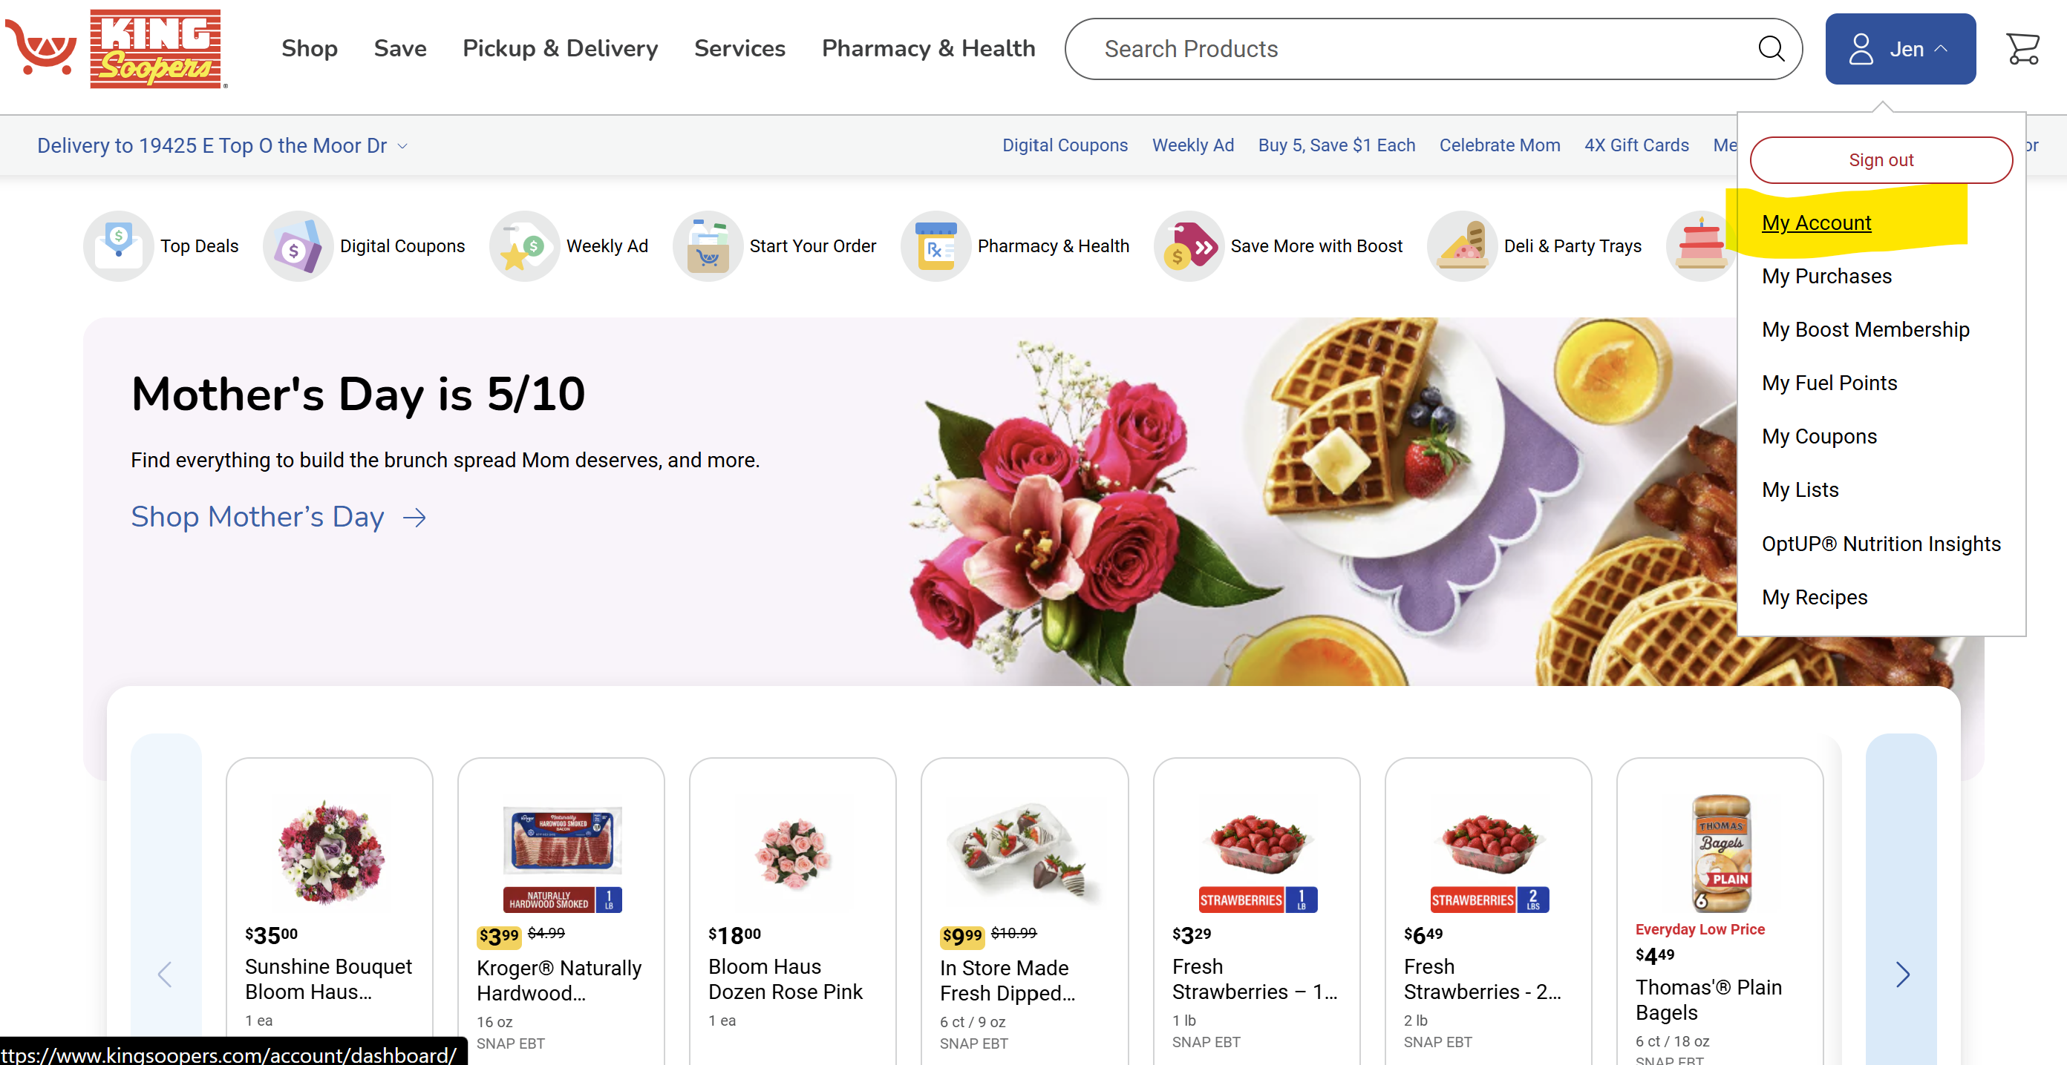

Log on to your account on top right “sign in”
Tap your name on top right then tap “my account”
King Soopers

Slide 3
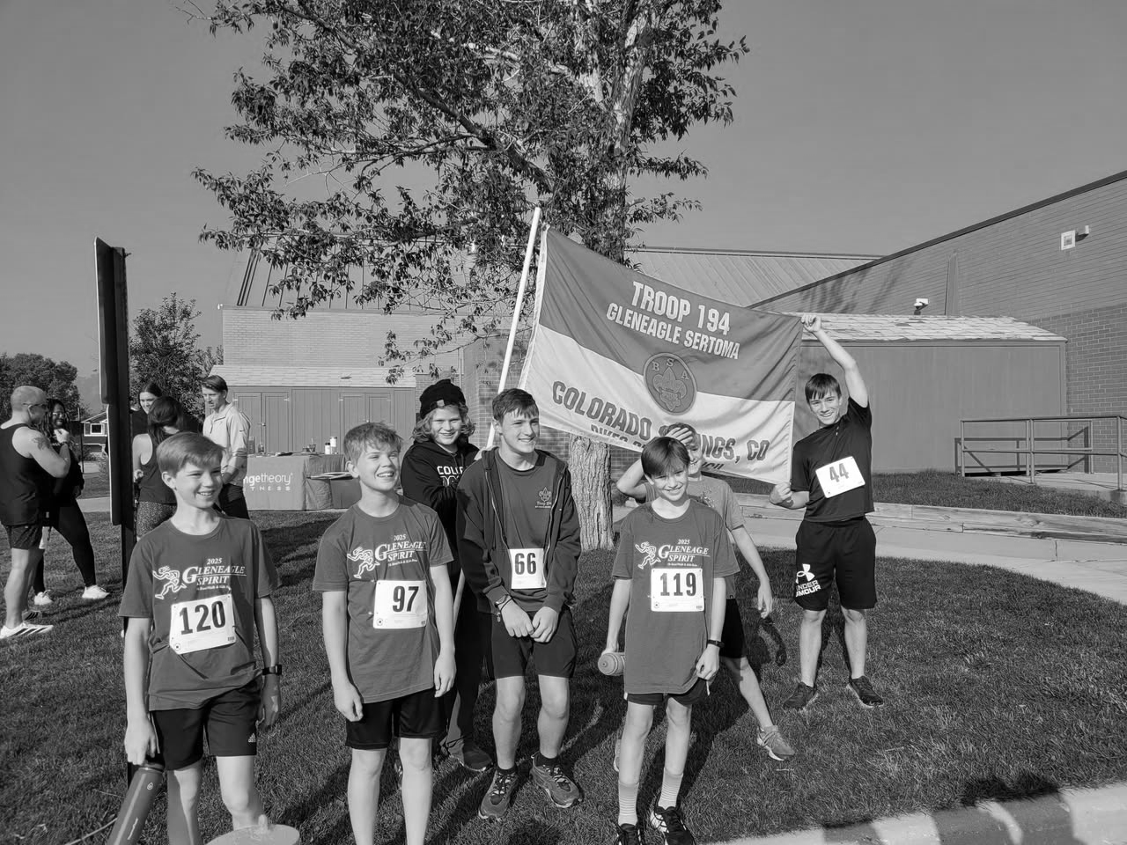
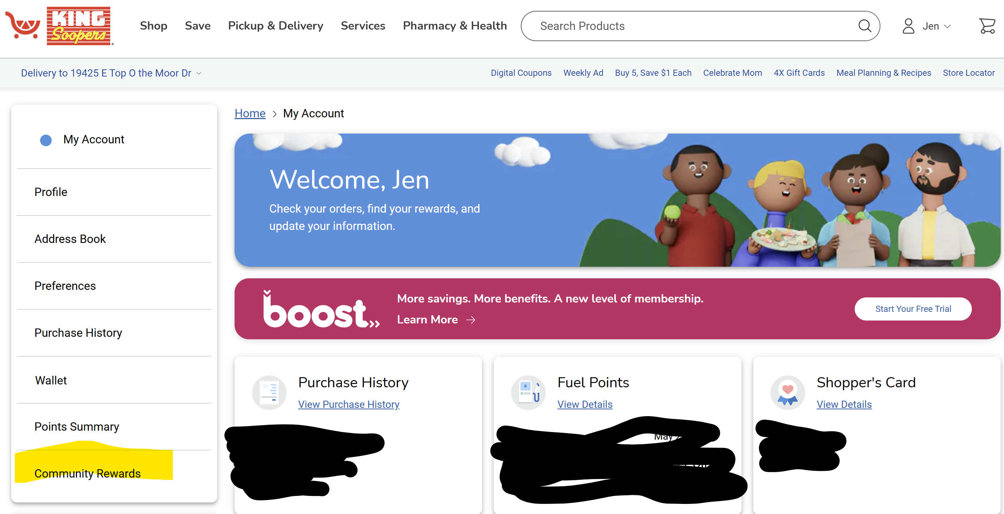
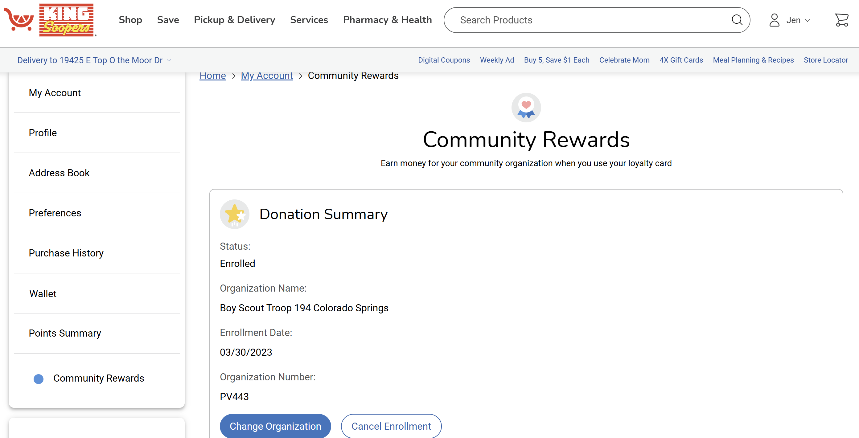
King soopers cont.
Click on community rewards left bottom
Search for Boy Scout Troop 194 Colorado Springs and select

Slide 4
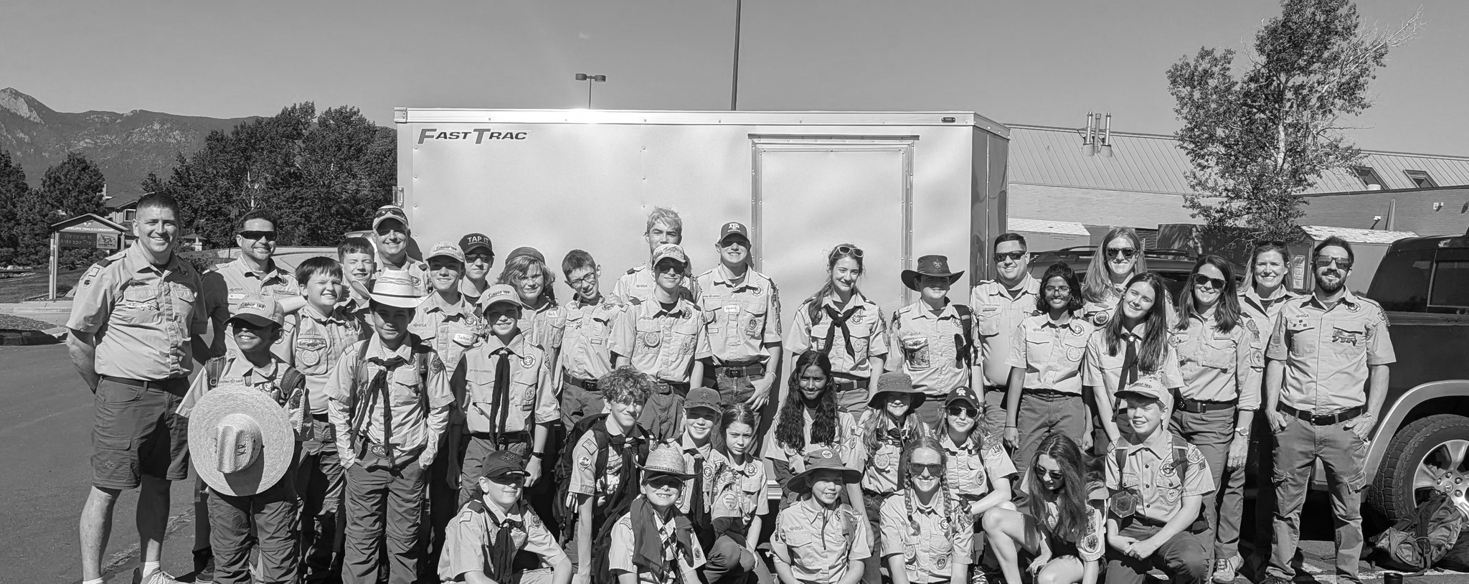

Thank you

